Slide 1
Presentation to Hayes Academy Bromley, UK
Presented by Principal
10 Apr 2013

Slide 2
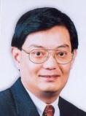
Every School, a Good School
A Good School
Hillgrove is a Good School that …
Cares for our students and knows their needs, interests and strengths. (E.g. pupil profiling)
Tailors our approach, policies and programmes to motivate students to learn and grow. (E.g. character devt, AEM/EMs)
Is recognised for our strengths and value-adding to students. (E.g. Academic rigor, CCA & Niche)
Minister for Education, Heng Swee Keat at MOE Work Plan Seminar 2012

Slide 3
School History
School History
Established to meet educational needs of children from Bukit Gombak, Bukit Batok
Founded in 2001 with 277 pupils - shared premises with Yusof Ishak Secondary School.
Moved to present location along Bukit Batok Street 52 on 2nd February 2002.
In 2013 - 1,175 pupils in 32 classes.
3rd Principal - Mr Kenneth Lee, assumed office on 15 Dec 2008
Notes:
Check alignment with report: 33 classes, 1255 pupils
School history not mentioned in report

Slide 4
Hillgrove Student Profile
Student Profile
As at 1 Jan 2013
Hillgrove students need more academic support:
Lower band of PSLE T-Score
Normal course
20% under MOE FAS
No of students
Express 631 (53.7%)
N A 399 (34.0%)
NT 145 (12.3%)
Total 1175
S1 Intake | S1 Exp Mean | S1 N(A) Mean | S1 N(T) Mean
2011 | 206.1 | 170.9 | 133.2
2012 | 204.9 | 171.4 | 131
2013 | 207.7 | 175.9 | 139.1
Student Residence
HDB 1-3 room 16.5% (CS 23.1%)
FAS 19.6%
Notes:
GT: Student profile to be changed to “pupil profile”

Slide 5
Student Perception of Hillgrove
Student Profile
SEM Pupil Survey | 2010 | 2011 | 2012
I am recognized for the good work that I have done. | 80.9% | 81.6% | 88.3%
I am able to develop my talents in school. | - | 77.2% | 84.6%
I am proud to be a Hillgrovian. | 82.9% | 82.0% | 90.2%
Sch Choice | S1 Exp 1st – 3rd | S1 N(A) 1st – 3rd | S1 N(T) 1st – 3rd
2011 | 86.6% | 90.1% | 84.6%
2012 | 73.9% | 86.3% | 97.5%
2013 | 86.3% | 96.3% | 100%

Slide 6
Work Experience of Staff
Staff Profile
As at 1 Jan 2013
Retirement of experienced teachers – loss of skilled practioners
Large no of less experienced teachers & AEDs – need to upskill
Newly-appointed KPs & STs – need leadership training
Years | Teachers (in Service) | EAS (in Service) | AED (in Service) | KPs & STs (in Appt)
1-5 years | 22 (38.6%) | 4 (26.6%) | 8 (100%) | 18 (78.26%)
6-10 years | 18 (31.6%) | 6 (40%) | 0 | 3 (13.04%)
11-20 years | 10 (17.5%) | 5 (33.4%) | 0 | 1 (4.35%)
> 21 years | 7 (12.3%) | 0 | 0 | 1 (4.35%)
TOTAL | 57 (100%) | 15 (100%) | 8 (100%) | 23 (100%)
Notes:
41.7% percentage teachers with less than 5 years teaching experience which is comparable to MOE-defined comparable schools. The percentage of Middle Managers (MM) within the first two years of leadership is also high at 61%.
To clarify what does “in appt” mean.
To clarify what does “in appt” mean.
*Not aligned to slides.
As a result, the school emphasized on building Professional Learning Community in teachers and leadership training in the management over the last three years.

Slide 7
Hillgrove Vision for 21st Century
School Vision
Every Hillgrovian is a person who:
Continually learns with passion and the spirit to do one’s best,
Cares for the needs of self, peers, family, others, environment and Singapore,
Makes a difference through the use of knowledge, talents and leadership.

Slide 8
Hillgrove Mission for 21st Century
School Mission
To nurture confident and passionate Hillgrovians who continually learn with a spirit to do one’s best, cares for and
serves others to make a difference.

Slide 9
Hillgrove Philosophy for 21st Century
School Philosophy
Potential
Character
Success
Hillgrove believes in me,
builds my character and
helps me succeed.

Slide 10
Hillgrove School Values & Motto
School Values & Motto
MOE Corporate Values (for staff)
School Values
(for students & staff)
Integrity the Foundation
People our Focus
Learning our Passion
Excellence our Pursuit
Integrity
Care
Respect
Responsibility
Resilience
United We Soar!
Notes:
Mention whats taken to develop school culture
*Show both MOE and school values, no need to map.
Integrity the Foundation We demonstrate moral courage and uprightness, being consistent in word and deed.
People our Focus We value people, seeking to bring out the best in everyone. Learning our Passion We embrace learning as a way of life, always ready for the future. Excellence our Pursuit We shall be the best that we can be, seeking continuous improvement in all that we do.

Slide 11
Hillgrove Outcomes for 21st Century
CCE Outcomes
MOE C2015 Outcomes | Hillgrove CCE Outcomes
Confident Person | Confident Person | Believes in oneself and is able to express ideas assertively.
Active Contributor | Concerned & Contributing Citizen | Responsible, cares for school, community, and nation.
Concerned Citizen | Adaptable Person | Accepts new experiences and has the resilience to take on challenges.
Self-Directed Learner | Passionate Lifelong Learner | Takes ownership of learning by learning avidly and constantly.

Slide 12
HGV CCE Framework
CCE Outcomes
Concerned & Contributing Citizen
Confident Person
Instructional Programmes
CCA
Values in Action
PE & Outdoor Education
LEARN:
Values Taught
CARE:
Values Caught
CCE Vision, Mission & Values
Leadership Programmes
CME
MAKE A DIFFERENCE:
Values Acted Out
National Education
Aesthetics
Passionate Lifelong Learner
Internationalisation
Programme
Adaptable Person

Slide 13
Hillgrove Strategic Thrusts
Strategic Thrusts
人
ST1: Academic Excellence - Offer a Value-added Academic Education
ST2: Holistic Student Development - Promote Character Building and Leadership
Ren
Person
ST3: Staff Capacity Building - Nurture a professional and caring staff
ST4: Strategic Partnerships - Foster Strategic Partnerships with the Community

Slide 14
Critical Success Factors
Success Factors
Systemness
Deep Pedagogy
Successful School System
Systemisation:
Best practices
Teacher learning
Collaborative professionalism
Leadership
Triangle of Success by Michael Fullan
Notes:
Learning in context and "systemness"
Work on individual standards-based development amount to naught without opportunity to learn in and help change contexts.
People need to practice in trenches with expert mentors and coaches.
Individuals won't be influential if the context doesn't change.
Never send a changed individual into an unchanged environment.

Slide 15
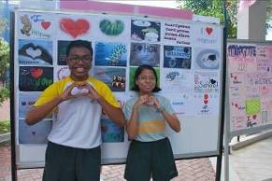
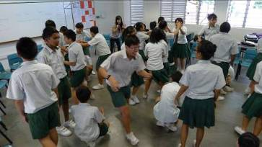
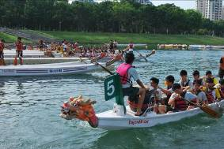
Our Hillgrove Family
School Tone & Culture
Build a positive, family-like school climate:
care for and respect each other
feel supported and recognized
students manage themselves
Positive Behaviour Support - teach socially desirable skills
Discipline with Care and Fairness
Level Prog
Class Family Time /
Circle Time (new in 2011)
Praise Cards

Slide 16
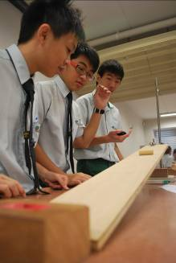
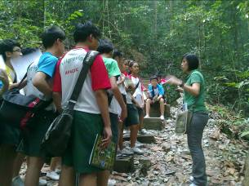
ST1: Academic Excellence
Offering a value-added
academic education

Slide 17
What is the end in mind?
ST:1 Academic Excellence
Love of Learning – passion in subjects, interest in further exploration
For Express pupils:
GCE ‘O’ Level Examination
For Normal (Academic) and Normal (Technical) pupils:
GCE ‘N’ Level Examination

Slide 18
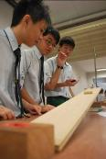
ST:1 Academic Excellence
ST1: Academic Excellence
Key Characteristics
4/5 year spiral curriculum
Differentiated instruction to cater to different abilities
ICT to enhance collaborative & self-directed learning
Target setting & monitoring of achievement
Focus on study skills & student motivation
Assessment for Learning
ST1 Staff Trg: Lesson Study, Pedagogy & Assessment, ICT, study skills & student motivation

Slide 19
ST:1 Academic Excellence
GCE ‘O’ Level Performance
Year | Sec 4 Express |  | Sec 5 Normal Academic
 | 5 or more 'O' Level Passes | L1B5 | 5 or more 'O' Level Passes | L1B4
2010 | 78.1 (87.6) | 25.0 (21.0) | 50.7 (44.1) | 23.2 (24.1)
2011 | 83.4 (88.8) | 23.2 (20.6) | 39.1 (43.8) | 24.0 (24.3)
2012 | 85.9 (80.3) | 21.8 (23.3) | 47.4 (47.2) | 21.6 (22.7)
( ) denotes MOE defined comparable schools data provided by MOE SCAN
Notes:
I will now present our performance for the 2010 GCE O Level results, compared to our previous year’s results.

Slide 20
GCE ‘O’ Level Performance
ST:1 Academic Excellence
4 Express | JC | MI | Polytechnic
2010 | 28.1% (51.2) | 58.7% | -
2011 | 39.0% (53.6) | 72.5% | 89.5% (93.7)
2012 | 45.0% (Not yet available) | 78.5% | 93.7% (Not yet available)
5 N(A) | JC | MI | Polytechnic
2010 | 10.1% (9.6) | 37.7% | -
2011 | 5.8% (8.7) | 27.5% | 63.8% (67.3)
2012 | 19.3% (Not yet available) | 50.9% | 78.9% (Not yet available)
( ) denotes MOE defined comparable schools data provided by MOE SCAN

Slide 21
ST:1 Academic Excellence
Student Perception of Learning
QSE Results | 2010 | 2011 | 2012
School support for learning (Sec 2) | 2.9 (3.0) | 2.9 (3.0) | 3.0 (3.0)
School support for learning (Sec 4) | 2.7 (2.9) | 2.8 (2.9) | 2.9 (3.0)
Teaching Practices (Sec 2) | 3.0 (3.1) | 3.0 (3.0) | 3.0 (3.1)
Teaching Practices (Sec 4) | 2.8 (3.0) | 2.9 (3.0) | 3.0 (3.1)
Engagement in learning (Sec 2) | 2.8 (2.8) | 2.8 (2.8) | 2.8 (2.9)
Engagement in learning (Sec 4) | 2.5 (2.8) | 2.7 (2.8) | 2.8 (2.9)
( ) denotes the national mean derived from all schools.

Slide 22
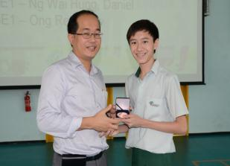
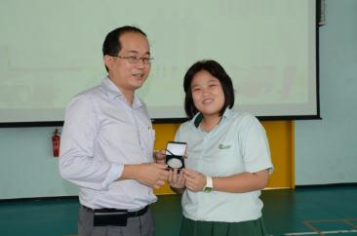
Principal’s Academic Award
ST:1 Academic Excellence
40 recipients in 2012
Encourage academic excellence
70% in overall marks for each term’s CA & SA
Sec One ( Bronze )
Secondary Two (Silver)
Secondary Three (Gold)
Secondary Four /Five (Platinum)
Platinum

Slide 23
2013 Careers Day (Sec 2-5)
ST:1 Academic Excellence
Aim: Professionals from a variety of fields invited to speak about their work
Date: 23 May 2013
Aviation Engineering
Maritime Engineering
Pharmaceutical Sciences
Entrepreneurship and Business Management
Digital Media and Infocomm
Hospitality
Sports, Health and Leisure
Psychology
Law Enforcement
Notes:
Key Goals:
To provide an opportunity for the students to explore possible career fields
To highlight the post-secondary courses available in the selected career fields
To give students insights about the subject knowledge and values required to succeed in the working world

Slide 24
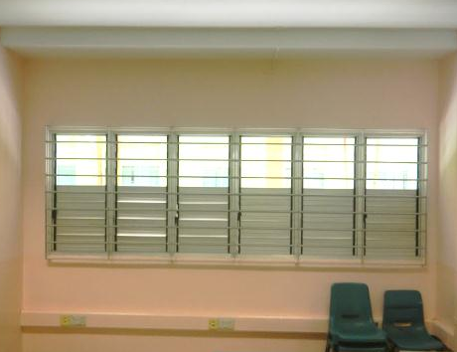
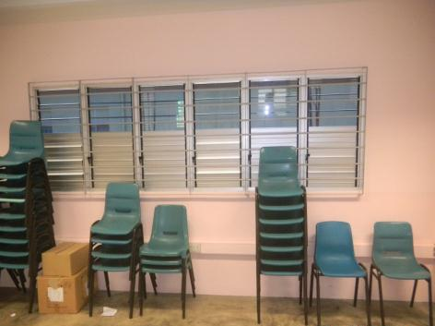
Installation of Anti-Glare Film to Windows in All Classrooms
ST:1 Learning Environment
Block out glare from sunlight - difficult to read from board or projector screen.
Reduce classroom temperature to make it more conducive for learning.
.
Before
After

Slide 25
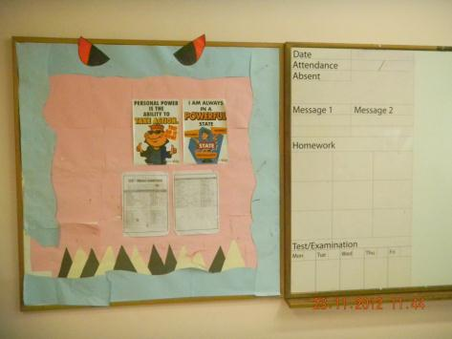
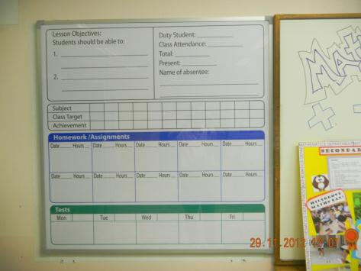
New Acrylic Whiteboard for attendance, homework, assessments & objectives
ST:1 Learning Environment
Enable teachers to state attendance, subject targets, lesson objectives, homework, upcoming tests/exams.
Students to check board to take responsibility for learning.
Before
After

Slide 26
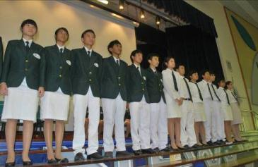
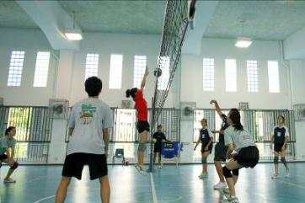
ST2: Holistic Development
Promoting character building
and leadership

Slide 27
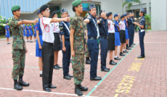
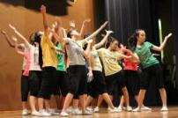
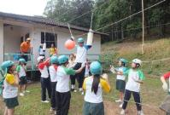
ST2: Holistic Devt
ST2: Holistic Development
Key Characteristics
Restorative Culture teaches values & builds relationships
Structured CCA prog with strong performance results
Vibrant Arts culture
Emerging Niche in Flight & Aviation
Expanding student leadership structure
Int’l & Level Progs develop 21st century competencies
ST2 Staff Trg: RP, SEL devt, CCA trg, awareness of F&A

Slide 28
ST2: Restorative Culture
Restorative Culture @ Hillgrove
Tertiary Prevention - Individual and high-intensity support for high-risk students (Repairing relationships
Parent-teacher collaboration, regular counselling by FTSC, Enhanced STEP Up Prog Service B,
Outreach Prog, Service-Learning Club, NA/NT SEL Prog, Outdoor Programme for NT
Secondary Prevention
Group behaviour support for at-risk students
(building relationships)
Primary Prevention - Provide guidance and behaviour support to all students
(Strengthening and reaffirming relationships
CME, PC Prog, CIP Prog, Circle Time, Level Merit System, PRAISE Cards, Commendation Awards
Notes:
What is PBS?
Positive: Focus on what we want students to do
Behaviour: Focus on specific behavioural expectations
Support: Focus on expectations and rewarding
students for desired behaviours
It deemphasizes punishment based procedures
Teaching adaptive and socially desirable skills puts the focus of PBS on skill building instead of on behaviour reduction.
PBS replaces problem behaviour that interferes with a person’s quality of life with behaviour that improves a person’s quality of life
Multiple interventions that are implemented across time in multiple settings by multiple people
Characteristics of PBS
PBS is based on understanding what is the underlying cause (function) of the problem.
PBS addresses the function.
Multidimensional: includes strategies related to setting events (prior to antecedents), antecedents (trigger event), teaching, consequences etc.
1st level of intervention for all offences
Correction, Instruction, Modelling (CIM)
Coordinate efforts of all teachers involved (FTs/co-FTs)
Getting cooperation & support of parents
Referrals (to HOL & DM) only for 2nd & 3rd level of offences

Slide 29
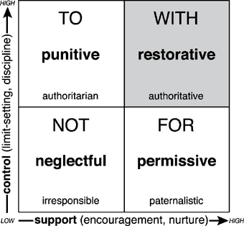
Restorative Culture @ Hillgrove
ST2: Restorative Culture
Key Goals
Building relationships,
Preserving relationships,
Restoring relationships
Social Discipline Window
Source: Intl Institute for Restorative Practice

Slide 30
3-Tier Student Management System
ST2: Tone & Culture
Whole School Approach to Discipline
Discipline with Care and Fairness
Level Three
Close Collaboration with Parents & School Counsellors
Guidance & support of Level Advisors & School Leaders
DM
(assisted by OMs)
Level Two
Heads of Levels
Level One
Subject Teachers & Form Teachers
Notes:
1st level of intervention for all offences
Correction, Instruction, Modelling (CIM)
Coordinate efforts of all teachers involved (FTs/co-FTs)
Getting cooperation & support of parents
Referrals (to HOL & DM) only for 2nd & 3rd level of offences

Slide 31
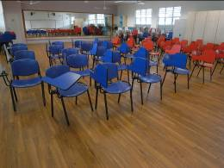
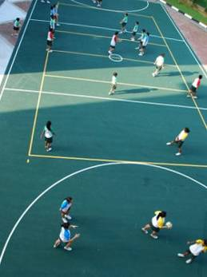
ST2: CCA
Inculcating Passion & Purpose through CCAs
Committed to grow CCAs - new level of strength / achievement:
Meaningful and structured 30-week prog for each CCA
Building/renovation of CCA facilities
CCAs & SiAs to cater to student interests:
2010 - structured S1 talent identification and allocation; student forum for CCA feedback
Seminar Room cum Dance Studio
Netball Court

Slide 32
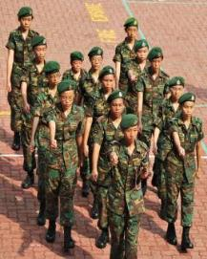
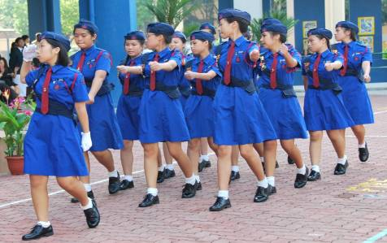
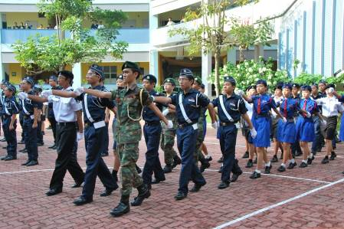
ST2: CCA
UGs Performance for 2012 Best Unit Competition
SJAB :Corps Achievement Award (Silver)
NCC (Land): Best Unit Competition (Bronze)
NPCC : Unit Overall Proficiency Award (Silver)
Girls’ Brigade: Company Award (Silver)
Boys’ Brigade: JM Fraser Award for Excellence (Silver)

Slide 33
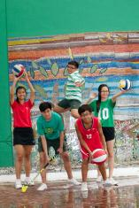
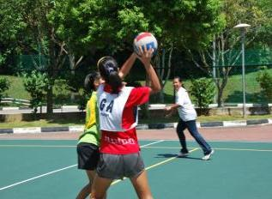
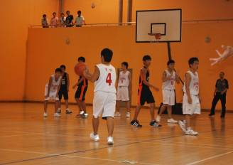
ST2: CCA
2012 Sports Performance
Netball | > M1 School Challenge League- 2nd place (B Div Girls) 1st place (C Div Girls)
Basketball | > Qualified for 2nd Round West Zone Inter-School Basketball Tournament – ‘C’ Division
Volleyball | > Qualified for 2nd Round of West Zone Inter-School Volleyball Championship (C Div Girls) - Top 6 placing > Singapore 3v3 Beach volleyball Under-17 Championship – 4th placing

Slide 34
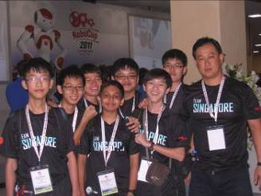
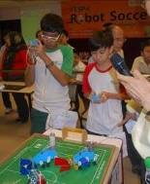
ST2: CCA
Technology @ Hillgrove
Robotics Club
Infocomm Club
Robotics
RoboCup 2012, Singapore
 1st placing in CoSpace Rescue category
 6th placing in CoSpace Rescue category
 1st placing in Rescue A category (under 14)
 2nd placing in rescue A category (under 14)
CoSpace Rescue Challenge
 Junior category (1st & 2nd place)
 Senior category (1st & 2nd place)
Science & Technology Challenge@NYP
 Radio-controlled Soccer Category (Champion)
 Radio-controlled Aircraft Category (Innovative Team Award)
Infocomm Club
Schools Digital Media Awards 2012
Merit Award

Slide 35
Arts Education
National Arts Education (Spark) Award, 2011-2012
Three-tiered strategy of Aesthetics development:
Learning about the Arts
Mosaic (Sec 1), Performing Arts Elective Modules (Sec 2), Theatre Experience Programme (Sec 3)
Caring about the Arts
Wide-range of Aesthetics CCAs, oppor to perform,
Making a Difference with the Arts
Outreach to community and to primary schools
SEM Pupil Survey | 2010 | 2011 | 2012
I have learnt to appreciate the visual and performing arts (visual art / music / dance / drama) because of the programmes offered by the school. | - | 85.2% | 92.6%
The school has given me opportunities to watch and enjoy performances by performing arts groups. (music / dance / drama) | - | 88.0% | 94.1%

Slide 36
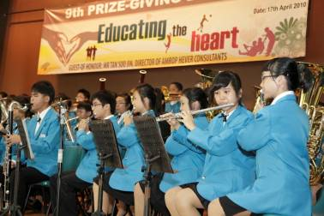
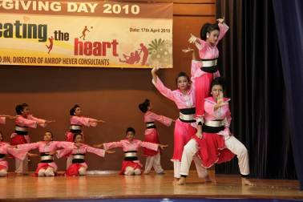
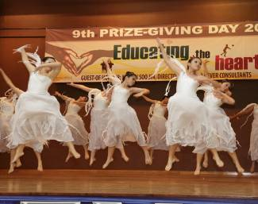
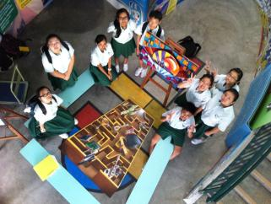
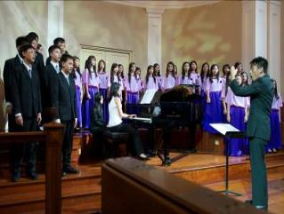
ST2: Aesthetics
Aesthetics Performance at SYF 2011
Concert Band- Silver
Malay Dance- Silver
Modern Dance- Bronze
2011
Drama- Trinity Guildhall Performance Arts Examination.
Grade 4 – Distinction
Art Club – Silver & Bronze 2012
Choir- Silver

Slide 37
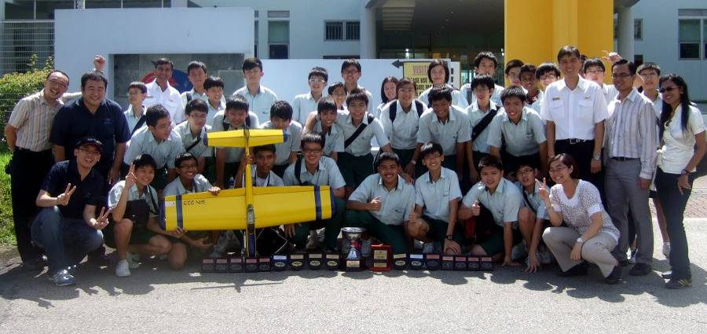
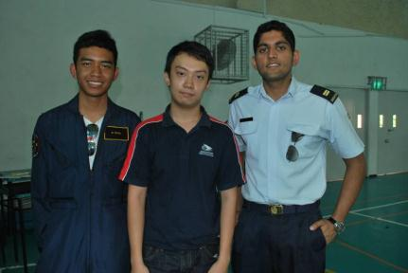
F &A Leader: Youth Flying Club
YFC Graduants who have gone
on to fly with SYFC (& Airforce)
INTER SCHOOL AEROMODELLING COMPETITION 2012
Chuck Glider Event (Silver), Junior Indoor Pylon Racing (Champion & 1st runner-up), Senior Indoor Pylon Racing (Champion, 1st runner-up & consolation), Overall Championship (2nd runner-up)
SINGAPORE AMAZING FLYING MACHINE COMPETITION 2012
Category B (Un-Powered Glider) :
Best Range Award (Gold) , The Most Creative Award (Bronze),
Category C (Radio Control Flight) :
Championship (2nd), Best Performance Award (Silver)

Slide 38
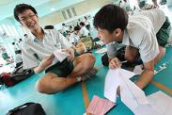
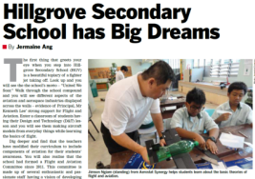
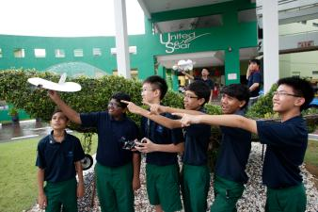
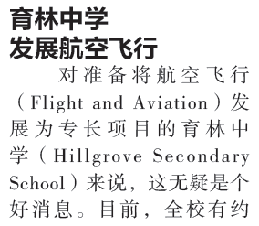
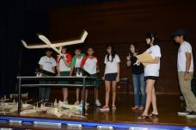
Emerging Niche – Flight & Aviation
ST2: F&A Niche
Aviation Dreams Take Flight (MOE Schoolbag.sg)
8 Nov 2012
F&A Explorer (Sec 1 & 2)
F&A Enthusiast (Sec 3)
F & A
F&A Leader (YFC)
Aerospace Spore vol 5 No 4 2012

Slide 39
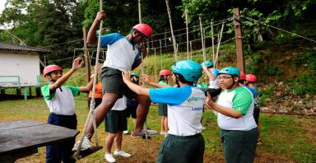
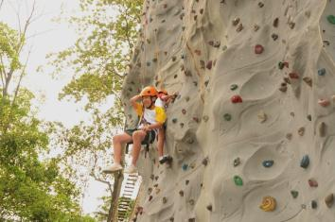
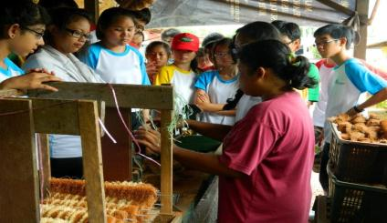
21st C Interdisciplinary Learning
ST2: 21st C Skills
Concurrent Term 1 Activities
S1 Relational Camp
S2 Malacca Trip
S3 Adventure Camp (Pahang)
S4-5 Study & Life Skills
S3 Adventure Camp
S1 Relational Camp
S2 Interdisciplinary Trip to Malacca
Notes:
However, we recognise that a few of the key 21st century outcomes will be more effectively grown outside of our classrooms.
Therefore since last year, most of us have packed our bags and gone off for different team building and possibly life changing experiences.
Since 2010, all Sec 2 students go off on an interdisciplinary trip to Malacca together, and this year, our Sec 1 student have also gone on their first camp at the Zoo.
In addition, the school organised 3 overseas trips last year to Vietnam and China to raise the global awareness of our students.

Slide 40
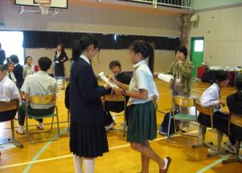
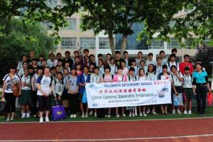
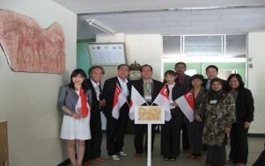
ST2: 21st C Skills
Nurturing Global Awareness & Cross-Cultural Skills
From 2012, at least 2 overseas LJs per student.
2013 Overseas Learning Journeys/ Competition
S2 Level – Malacca, Malaysia
S3 Level – Pahang, Malaysia
HIP – Xian, China
HIP – Japan (hosting)
1 CCA - Incentive Trip
HIP Japan
HIP China

Slide 41
ST2: Student Leadership
2013 Student Leadership Framework
Student Leadership Committee
Student Leadership Executive Committee (SL EXCO)
SC EXCO
CCA Council
Community
Council
ACE EXCO
Class Council
Student
Councillors
CCA
Leaders
Community
Ambassadors
ACE
Leaders
Class leaders
Notes:
Approach to 2013 SL groups
Our philosophy is to provide multiple and varied leadership roles and opportunities to cater to student’s interests and talent.
Based on the Student Council’s established system and processes. (To build on our strength and modified it to other student leadership groups.)
Recognition of new SL groups to enhance motivation and purpose

Slide 42
Student Leadership Results
ST2: Student Leadership
Performance Indicators (Student Leadership) | 2010 | 2011 | 2012
% of pupils holding formal leadership roles | 14.3% | 35.0% | 47.0%
% of graduating pupils who obtained 1-12 leadership points under LEAPS | 35.8% | 41.6% | 53.5%

Slide 43
Student Leadership Results
ST2: Student Leadership
SEM Pupil Survey | 2010 | 2011 | 2012
I have opportunities to be involved in making the school better. | - | 78.5% | 88.0%
I have opportunities to undergo training as a leader. | 83.2% | 86.1% | 83.1%
My participation in CCA has helped me to develop my leadership skills. | 84.0% | 84.3% | 86.5%
The school gives students opportunities for leadership training. | 77.5% | 87.9% | 92.0%
The student leaders (Councillors, CCA leaders and Class Leaders) are effective. | 74.6% | 74.7% | 84.2%

Slide 44
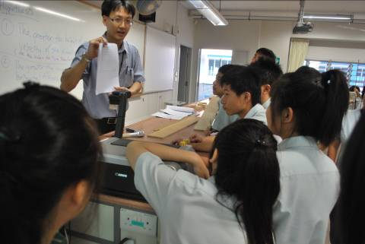
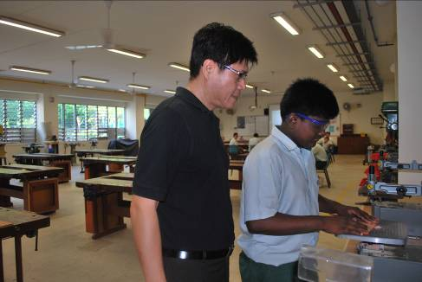
ST3: Staff Capacity
Nurturing a professional
and motivated staff
Notes:
I would now like to present our strategic thrust of nurturing a professional and motivated staff.

Slide 45
Bridging Gap btw Current & Desired Staff Culture
ST3: Staff Culture
Initiatives and programmes
Teacher Work Mgt Framework (TWMF).
Work-life balance through staff wellbeing activities.
Open culture, use of praise & encouragement, celebration.
Sustained and structured pedagogy and assessment training.
Deepen understanding and practice of Lesson Study & WITS.
Current School Culture
Relational trust between staff and leaders improving but uneven.
Improving work-life balance.
Growing interest and competence in adopting effective pedagogy and assessment.
Desired School Culture
Open communication and deep relational trust between staff and leaders.
Strong work-life balance.
Deep interest in improving professional craft and collaboration within a PLC.

Slide 46
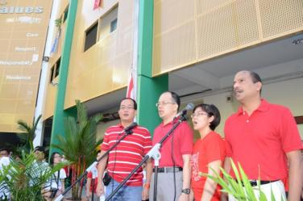
ST3: Staff Culture
Growing School Values amongst Staff
Nurturing and supporting the growth of school values in staff through 4 key processes:
Staff Induction, Mentoring & Coaching, Role-modelling & Mgt by Walkabout
Key Learning Progs for Staff
Caring for Staff through Well-Being Progs
Staff Appraisal & Recognition
School Leaders leading the way in singing of National Day anthem

Slide 47
Approach to Leadership Resource Planning
ST3: Leadership
Three Rs of Leadership Resource Planning:
Recruit
Scout for KPs and teachers with leadership potential; Explain Hillgrove’s vision, culture & what we offer.
Retain
Offer leadership devt opportunities; Look after leaders’ needs & wellbeing; Nurture school spirit and loyalty.
Renew
Leadership devt opportunities; Ideas & effort for sch improvement; Collaboration & bonding.
Notes:
Leadership includes leaders and aspiring leaders in leadership and teaching tracks
Retain
Offer leadership devt opportunities:
Devt of specific competencies unique to each leader
Career progression – HOD, VP, ST/MTT
Look after leaders’ needs & wellbeing:
Listen to leaders’ voice and concerns
Recognise contributions
Nurture school spirit and loyalty
Recruit Right Talent
Through APEX & networks
Scout for leaders and officers with leadership potential
Listen to needs of leaders – hopes, aspiration, fears
Explain what Hillgrove’s culture & what we will offer them
Renewing the Mind, Soul & Spirit
Initiate Learning Community of Servant Leaders – for development, collaboration & renewal (from 2010)
Tap leaders’ ideas for school improvement
Organise games & bonding activities for leaders

Slide 48
Building Strong Depts & Committees through Leadership Devt
ST3: Leadership
Recruit KPs, STs & high potential officers
Develop & appoint aspiring KPs
Build strong department teams
Homegrown KPs
Mr Kenneth Lee
Tee Chong
Principal
Imported KPs
Mdm Ong Fei Min
Vice-Principal
Mr V Harindranath
Vice-Principal
Mr Lye Deli
Vice-Principal (Admin)
Mr Marcus Teo
HOD/EL & Lit
Mdm Salbiah HOD/
MTL
Mrs Jennifer Peng
HOD/SC
Ms Chong Mui Choo
HOD/
MATH
Mdm Jean Khoo
HOD/ Humans
Mr Ramesh Ramiya
HOD/PE & CCA
Mr Lennie Chua Yang Ming
HOD/ACT
Mr S Thiru
HOD/Char Devt & Guidance
Mr Teo Yee Ann
HOD/ Discipline
Mdm Lee Li Lian
HOD/ICT
Mdm Grace Tang
SSD
Ms Usha Wassan
LT/Chem
Ms Siti Hajar
LH/EL & Lit
Mdm Wong Huey Jeen
SH/CL
Mdm Yong Siew Fai
ST/Bio
Mrs Valerie Loh
ST/Math
Ms Ang Rei-Wan Karen
LH/Math & Sch Info Mgt
Mr P Siva
SH/SS & CE
Mr Eric Foo Chee Sian
SH/Std Ldrshp & Partners
Ms Lim Sik Choo
SH/Design & Tech
Mdm Chong Huien
SH/ Aesthetics
Mdm Kwek Yu Zhen
SH/Charac Devt
Mdm Teh Gaik Lean
ST/ICT

Slide 49
ST3: Leadership
ACS Model of Leadership Devt
Talent Management –through varied leadership assignments
Succession Planning - nurturing second echelon leaders/potential KPs
Challenge
Leadership assignments
Sch-Level – HOLs, Comm heads
Dept-Level Subject Coords
Group-Level (LS & WITs facilitators, CCA OICs, FTs)
Assessment
Capabilities, needs, AFIs thru job preference survey, appraisal
Individual Career Devt Plan (CDP)
Half-yearly performance assessment
HGV
Leadership
Development
Framework
Support
Job briefings
Mentoring / Coaching by STs, W2 STs, HODs, LAs
Training
Adopted from Centre of Creative Leadership (CCL) in USA
Notes:
Assessment-Challenge-Support (ACS) leadership development framework is used to nurture leadership talent for achievement of school goals by:
Providing opportunity to leadership opportunities for staff to learn, grow and change
Enabling responsibility for one’s own development and continued effectiveness

Slide 50
SMC, ST & Aspiring Leaders Training
ST3: Leadership
Sch Training (All):
Systems Thinking
Servant Leadership - 2010 Personal Mastery as a Leader; 2011 One-to-One Coaching; 2012 Building Effective Teams
Lesson Study, Pedagogy
Leadership Learning Journey to MHP
Cluster/MOE/External Training:
LAMP (within 1 yr of appt), MLS – (All)
SEM EV attachment
Overseas LJs (by cluster/MOE)
CSC Leadership Courses
Relevant leadership trg e.g. PDS
Work attachment with VP/HOD/LT/ST in another school
Mentoring & Coaching by SLs, senior KPs/STs
Leadership Reading & Discussion at SMC

Slide 51
ST3: Prof Devt
Innovating in Curriculum, Pedagogy & Assessment through Lesson Study
Constant professional dialogue and collaboration to improve craft of teaching & student learning.
Timetabled time every Tues
All dept leaders, STs & aspiring KPs lead
All teachers participate
Lesson Study
ST1: Academic Excellence
Lesson Study Process
Key Phases of Lesson Study
Problem Identification
Lesson Planning
Trialing & Lesson Obs
Modification of Lesson
Retrialing & Lesson Obs
Dept-Specific Pedagogy Trg by Dept Leaders, NIE
School-Wide Pedagogy Trg
PETALS: Pedagogy, Experience of Learning, Tone of Environment, Assessment, Learning Content
ST2: Building Staff Capacity
Notes:
YES

Slide 52
Lesson Study System
ST3: Prof Devt
Innovating in Curriculum, Pedagogy & Assessment through Lesson Study
Monthly Teacher Learning Space (TLS)
LS training – Observation & Reflection
Whole-school Lesson Study
Observation by all trs (selected lessons)
Annual Lesson Study Seminar
Lesson Study in LSLC
Each tr is observed once a year
Subject Grp or Cross-Discipline Lesson Study
Each tr to teach 1 ICT/CoL lesson a year
Each tr will observe 3-4 lessons a year
Weekly Curriculum Development Space (CDS)
Subject + 4 cross-disciplinary groups

Slide 53
ST3: Prof Devt
Teachers Collaborating to Innovate
2012 Example:
Cross-Disciplinary LS Groups
CME - Motivation of students through study skills
Sec 1 ICT - Strategies for ICT-enabled T-L
Sec 3N(A) Lower Ability Learners - Strategies to optimise student attention and learning
S3NA - Original U-Shaped Seating Arrangement
S3NA - New Collaborative Seating Arrangement

Slide 54
Innovating with Partners Yonamoto Elementary School, Japan
ST3: Prof Devt
Good practices observed and adopted:
Restrict subject banding to enable teachers to have more time to engage in LS observation.
Seating arrangements for students discussed prior to observation.
Assignment of trs to each student group.
Use Skillful Teacher competency pyramid to enable focused devt of teacher needs, and modify observation template accordingly.

Slide 55
ST3: Prof Devt
Innovating with Partners
Lesson Study Community of Practice
To foster professional collaboration among instructional & school leaders involved in LS
Partners sec schs – Clementi Town, Broadrick, Dunearn and Bukit Batok
LS Leadership – for SLs and SSDs share leadership perspectives on growing LS
LS Practitioner – for instructional leaders and trs to learn through LS lesson observations and training

Slide 56
ST3: Prof Devt
Innovating with Partners
Lesson Study Sharing/Observ with CTL, NIE
2011-2013 – LS sharing with Management of Leadership in Schools (MLS) prog participants with A/P Eisuke Saito
2013 – LS sharing with Senior Trs Prog (STP) participants with A/P Christine Lee
Sharing about school’s LS journey
Lesson observation & feedback given to trs

Slide 57
ST3: Prof Devt
Innovating with Partners
Lower Sec EN-ELT Prog with CPDD, 2013-2014
Aim of Enhancing English Learning and Teaching:
Enhance pedagogy in English Language teaching, with the implementation of EL Syllabus 2010
Deepen teacher leadership in school-based curriculum planning, development and curriculum
First half of 2013
Retelling training MOE officers and project consultant
Mentored by Dr Lydia Tan-Chia, MOE, CPDD (EL Unit)
Teachers conducted a LS cycle using strategy taught
Notes:
Enhance pedagogy in English Language teaching, with the implementation of EL Syllabus 2010
-> help teachers grow professionally in ELT so that students will be adequately prepared to meet the demands of the Upper Secondary
Deepen teacher leadership in school-based curriculum planning, development and curriculum
-> expose yound leader(s) heading the department in planning, development and curriculum

Slide 58
ST3: Prof Devt
Innovating with Partners
Music Pedagogy with STAR / NIE
2012: STAR pioneering research on effectiveness of informal/non-formal music pedagogy in developing 21CC.
2013: Continuing research with STAR as part of Arts Pedagogical Research Fund programme
2013: Championing within W2 cluster use of informal / non-formal music pedagogy to craft student-centric music lessons.

Slide 59
Staff Well-Being
ST 3: Staff Well-Being
EAS Lounge
Minimise afternoon meetings
Renovated Teachers & EAS Lounges
Hillgrove Family Day
Hillgrove Appreciation Day – include EAS
Staff Games Day
Renovated Fitness Room
Staff VIA
Staff Fitness Training
Staff Games Day
Staff CIP

Slide 60
Staff Engagement Tea Sessions
ST 3: Staff Well-Being
Annual Process of Listening to Staff Voice
Annual feedback/tea sessions with EOs and EAS since 2009
Small group sessions chaired by School Leaders and selected HODs (from 2013)
Staff feedback gathered is collated and analysed by SLs and relevant HODs
Collated feedback and suggested solutions shared with SMC & STs for follow up action
Finalised feedback is shared with EOs at SCT, EAS at dept mtg, or in original feedback groups

Slide 61
ST4: Strategic Partnerships
Fostering strategic partnerships

Slide 62
Hillgrove Partnership Framework
ST4: Strat Partnerships
Key Aims
Identify strategic partners to achieve vision & strategic goals
Map out strategic & mutually beneficial areas of collaboration
Identify key factors contributing to success of partnership.
School Programmes / Student outcomes
Key Partners
ST2: Character Devt - Sungei Buloh WR, Bukit Gombak CCC
ST1 – IHLs, Mutsumi JHS, Xian 38th HS, UK schs
Key
Principles
ST2: CCA – NCC, SYFC, SCDF
P1: Student-centric,
Values-based Education
Hillgrove Vision, Values
& 21 CC
P2: Purposeful & Mutually Beneficial Collaboration
ST2: Flight &
Aviation – SYFC, CAAS, ITE Aerospace,
SP Aerospace
ST3 – NIE CTL
P3: Sustainability of outcomes
Notes:
Review of School Partners’ Framework – headed by VP(Admin)
Align with Vision & Mission
Identify strategic areas of partnerships with SAC, parents, alumni, IHLs and community
Principles guiding development of strategic partnerships

Slide 63
Benefits of Partnership
ST4: Strat Partnerships
Key Partners | Key Aims | Activities / Initiatives
SAC | Provide advice and support to school | Funding staff/student programmes, talks, visits to poly
PSG | Provide advice and support to school | Parents representation to support school programmes
Alumni | Provide advice and support to school | Role models to support school programmes
SP, NP, RP, PJC, ITE | To enable students to learn about JC, polytechnic & ITE education | Visits for Sec 4/5 students; streaming talk for Sec 2 parents; talk on JC/poly ed for Sec 4 parents
Xian 38 High School, China | Global, inter-cultural awareness for students | Twinning programme (Singapore and China)
Mutsumi Junior High, Japan | Global, inter-cultural awareness for students | Twinning programme (Singapore and Japan)
Centre for T & L, NIE | Build Lesson Study competencies in teachers | Lesson Study training, observation and participation in LS conferences
Bukit Gombak GROs | Opportunities to contribute to the community & support for fundraising | Green@Hillgrove, support for community events, fundraising for the school
Sungei Buloh Wetland Reserve | Opportunities for our students to show care for the environment | CIP for Sec 2 (mangrove planting and coastal clean up) Environment club activities
St. Luke’s Hospital, New Horizon Centre | To provide opportunities for our students to help the elderly | Service learning by all Sec 3 classes at St Luke & selected CCAs at New Horizon Centre

Slide 64
Any Questions?

