Slide 1
Singapore’s Education System
Presentation to Hayes Academy Bromley, UK

Slide 2
Key Facts and Figures
FY12 Budget: S$10.6 billion ≈ 3% of GDP
Schools:
  356 schools
  510,000 students, 33,000 teachers, 7,400 education partners (which include allied educators; executive and administrative staff)
Tertiary Education Institutions:
  4 Autonomous Universities (AU), Singapore Institute of Technology (SIT), UniSIM, 5 Polytechnics, 3 Colleges of Institute of Technical Education (ITE)
  161,000 students, 11,000 teaching and 13,500 non-teaching staff
Notes:
Singapore is a multi-racial, independent city state with a current population of 5.31 million. To give you a quick sense of our education system, allow me to highlight some key facts and figures:
Our 2012 education budget is S$10.6 billion (about 3.0% of our GDP) [or about US$8.8 billion]
We have 356 schools – comprising of 174 primary schools, 154 secondary schools, 15 Mixed Level schools and 13 JC/Centralised Institute.
Our post-secondary education institutions, namely Polytechnics, Institute of Technical Education and Autonomous Universities enroll around 161,000 students, supported by 11,000 teaching and 13,500 non-teaching staff (Note: figures do not yet include SIT and UniSIM)

Slide 3
Presentation Outline
(1) Evolution of Singapore’s Education System
(2) Current Trends in Singapore’s Education Landscape
    Delivering a Student-Centric, Values-Driven Education
    Nurturing a Quality Teaching Force
Notes:
Today’s presentation will bring you through an overview of the evolution of our education system before looking at current trends in our education landscape.
We will touch on our vision of delivering a student-centric, values driven education as the way forward for us, look at how we grow a good teaching force and wrap up with information on our higher education sector.

Slide 4
(1) Evolution of Singapore’s Education System

Slide 5

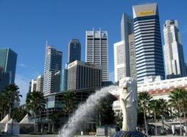
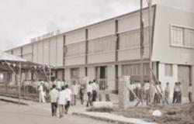

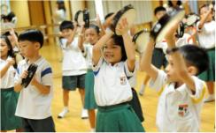
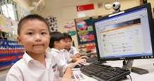
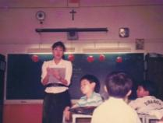
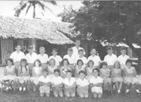
Our Education System Evolved with the Times…
Singapore’s Education System Has Evolved…
Phases of our economic development…
Innovation-
Driven
Knowledge-Based
  Student-centric, Values Driven
  2012 onwards
Skills/Capital-Intensive
Ability-based, Aspiration Driven
  1997 – 2011
Industrialisation
Efficiency Driven
  1979 – 1996
Survival Driven
  1959 – 1978
Notes:
5
Our education system has evolved considerably since the Ministry of Education was set up about 5 decades ago. Education policies have continually evolved in tandem with our nation’s development.
These changes can be broadly characterised by four phases.
Survival-Driven. In our early days, our education policies were driven by survival and nation building, where focus was on mass education, and developing skilled labour to drive industrialisation.
2. Efficiency-Driven. From the late 1970s, We had high enrolment rates, but also high drop-out rates. Efficiency was thus a focus to improve progression outcomes. There was also a need to cater to a more skills-intensive economy and with more capital-intensive industries.
3.Ability-Based, Aspiration Driven. The 1990s saw us transit into a knowledge-based economy.
Our focus shifted from efficiency to quality, flexibility and choice in learning.
We sought to develop a broader range of skills, such as critical thinking and creativity.
This was accompanied with greater devolution of autonomy to our schools.
4.At MOE’s Work Plan Seminar in 2011, Minister signalled a shift towards a Student-Centric, Values Driven phase of education.
We have achieved good outcomes so far, we need to continue to improve in order to prepare our students for success in the future. To do so, our education system must evolve – one that is not centered solely on knowledge acquisition, but also develops character and imparts process skills and values that would be useful for life. With an increasingly uncertain future that increasingly values innovation.
We need to equip our children with a range of higher order skills to prepare them for the challenges of a globalised world
We need to equip our young with values and character so that they remain rooted and those who do well must feel a sense of gratitude in contributing back to society.
5

Slide 6
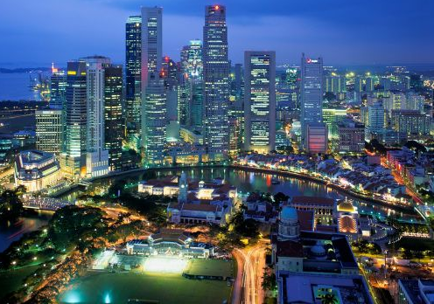
… But is Reflective of Some Enduring Truths
A Key Role of Education is to Support our Economy…
  People are Singapore’s only natural resource
  Education prepares our children for joining the workforce in an increasingly uncertain and globalised world
  Close coordination to develop these connections
… While also Fulfilling the Aspirations of our Children
  Education is a key social leveller
  Helping children be the best that they can be
  Multiple pathways for success, customised programmes from schools
Notes:
As we evolve through our phases and from our earliest days, education in Singapore has had to balance two key truths: as people are our only natural resource, a key role of education is to support our economy; at the same time, we want to fulfill the aspirations of our children.
To ensure that education supports the economy, we have established close coordination between the economic and the manpower and education ministries. Our educational institutions also have close links with the industry through adjunct teaching positions and industry representatives on their academic panels.
We also recognise the need to fulfil the aspirations of our children. Education plays a key role as a social enabler. We aim to help children to be the best that they can be. We continue to explore initiatives, such as: implementing multiple pathways for success and allowing schools to develop customised programmes. Let me now elaborate more on these.

Slide 7
We Have Transformed Our Education Landscape…
Continuing Education and Training
University (27%)
Polytechnic
(43%)
Institute of Technical Education
(22%)
Junior College
(28%)
Secondary School (4-5 years)
Express (59%)
N(A) (25%)
N(T) (13%)
Primary School (6 years)
Notes:
The Cohort Participation Rates are shown in brackets.
99% of students progress to Secondary School. This includes some 1- 2% go to specialised schools that focus on vocational training, e.g. Northlight School, Assumption Pathway School.
93% of students progress to a Post-Secondary Education Institution (PSEI), i.e. JC, Poly, ITE
Current CPR for Publicly-funded Universities is 27%. On target to achieve 30% in 2015. Current Committee on University Education Pathways beyond 2015 is looking at further raising CPR through a new applied pathway.

Slide 8
… to Better Cater to Different Learning Styles/Needs
Work & Life
CET
Degree
Degree,
Diploma,
Skill Certs
University (3 – 4 years)
Diploma
Skill Certs
GCE A-Level / Other Qualifications
Polytechnic
(3 years)
Junior College
(2 years)
ITE
(2-3 years)
Alternative Qualifications
GCE O-Level / N-Level
Privately-Funded Schools
(4 – 6 years)
Specialised Independent Schools
(4 – 6 years)
Integrated Programme Schools
(4 – 6 years)
Secondary Schools
(4 – 5 years)
Specialised Schools
(4 years)
Special Education
Primary School Leaving Examination
Primary School (6 years)
Notes:
At the primary level, we have introduced subject-based banding to enable students with uneven strengths to learn at their own pace for each subject, either at a foundation or standard level.
At the secondary level, we now have various types of schools, such as:
Integrated Programme Schools (which allow top students in the Express stream to skip the O-Level examinations)
Specialised Independent Schools (which cater to exceptional talents in sports, arts, mathematics and science and applied learning)
Privately Funded Schools - which serve as a potential source of innovative ideas in curriculum and teaching, as well as provide an alternative choice of academic qualifications (like the International Baccalaureate).
While there is still streaming, there is even more porosity, and students can transfer laterally from one stream to another if they perform well
At secondary level, we also have Specialised Schools which cater to non-academically inclined students who require more hands-on learning with a vocational-based education e.g. Northlight School
We have also recently enhanced our Special Education to cater to students with special learning needs/disabilities. MOE will be piloting a new school-based dyslexia remediation in 20 primary schools islandwide in 2012 and 2013, at a cost of $3.6million. MOE will also improve the accessibility to Special Education (SPED) schools, through professional advice and financial support.
We have also put in place a Direct School Admission (DSA) scheme, which gives our schools and tertiary education institutions the flexibility to admit students based on their achievements and talents in areas which are not captured by our national examinations.
Going forward, we will continue to create more pathways for our secondary school students to achieve success based on their own abilities.
In line with our shift towards the student-centric, value-based education, our education system aims to prepare our students for work & life. The university degrees, poly diplomas and ITE certs are meant to be an means to an end, to prepare our students when they enter the workforce.
CET
Furthermore, the Singapore government actively encourages Singaporeans to continue with life-long learning even after they leave schools, through further studies to acquire a higher qualification through our PSEIs, or through the Singapore Workforce Development Agency’s Continuing Education & Training courses overseen by MOM.

Slide 9
Continued Increasing Investment in Education…
MOE’s Budget
$ (Billions)
> S$10 billion
or US$8.3 billion
10
10
8
Development Expenditure
8
6
6
Operating Expenditure
4
4
2
2
0
0
FY’11
FY’00
FY’05
Notes:
All these changes to improve our system have been supported by continued, and increasing investment in education.
MOE’s budget has increased from $6billion in FY2000 to more than $10billion in FY 2011.

Slide 10
…with Increases Benefiting all Students
Annual Recurrent Funding Per Student
↑35%
↑55%
↑70%
↑50%
↑110%
↑80%
Notes:
10
This slide breaks down MOE’s annual recurrent funding on a per student basis across different levels from primary to higher education.
The funding in 2010 is shown in yellow, and the corresponding figure 10 years ago is shown in green
The largest increase has been for primary school students, with a 110% increase compared to 10 years ago. This ensures that all Singaporeans are able to receive primary education of a high quality, regardless of where they stay in Singapore
As 97% of each P1 cohort progresses to secondary school, the 80% increase in funding for secondary school students will also benefit almost all Singaporeans
The increased funding has allowed schools to implement new programmes and initiatives to enrich students’ learning experience, and allowed us to expand and develop our teaching force to support these new initiatives
ITE and Polytechnics students are also benefiting from substantially higher funding per student – around 50% more than ten years ago. We have improved the quality and range of offerings at these institutions, and are upgrading their infrastructure and equipping them with state-of the art facilities. Funding per university student has increased but by a smaller percentage.

Slide 11
(2) Current Trends in Singapore’s Education Landscape
    Delivering a Student-Centric, Values-Driven Education
    Nurturing a Quality Teaching Force
11

Slide 12
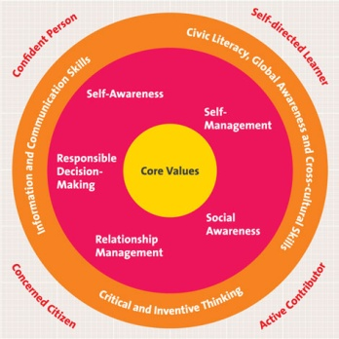





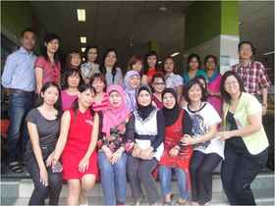

Delivering a Student-Centric, Values-Driven Education
4 Key Thrusts
SCHOOL
1. Holistic Education
2. Every School a Good School
3. Opportunities for All
4.Strengthening Partnerships
Notes:
Moving forward, MOE will focus on 4 key areas in the general education system to achieve our vision:
Holistic education – to balance academic and non-academic outcomes required for the future
Every school a good school – to ensure that each child can be best nurtured in a variety of schools suitable for their abilities and learning needs
Opportunities for all – Education remains an important social leveller and we will continue to ensure that everyone is able to access a good quality education regardless of their family background and circumstances
Strengthening partnerships – We recognise that parents and the wider community can play an important role as our partners to achieve our desired outcomes

Slide 13
1. Delivering Holistic Education:-
Desired Student Outcomes and the 21st Century Competencies
Civic Literacy, Global Awareness and Cross-cultural Skills
Confident Person
Self-directed Learner
Information and Communication Skills
Self
Awareness
Self
Responsible
Decision
Making
Management
Core
Values
R³ICH Core Values
Respect
Resilience
Responsibility
Integrity
Care
Harmony
Social
Concerned Citizen
Awareness
Relationship
Active Contributor
Management
Critical and Inventive Thinking
Notes:
To prepare our children for the future, we seek to imbue in them core values of (i), respect, (ii) resilience, (iii) responsibility, (iv) integrity, (v) care and (vi) harmony, as well as social and emotional competencies that will enable each of them to succeed in life and be socially responsible persons.
We strive to equip them with key competencies required in the 21st century: (i) information and communication skills, (ii) civic literacy, global awareness and cross-cultural skills, and (iii) critical and inventive thinking.
So that they will become (i) confident persons, (ii) self-directed learners, (iii) active contributors, and (iv) concerned citizens.
We aspire for every student to achieve these desired outcomes upon completing his or her formal education, and these will be guiding our work in rebalancing our education system towards holistic education.
Desired Student Outcomes
The desired outcomes for every student are:
- a confident person who has a strong sense of right and wrong, is adaptable and resilient, knows himself, is discerning in judgment, thinks independently and critically, and communicates effectively.
- a self-directed learner who questions, reflects, perseveres and takes responsibility for his own learning.
- an active contributor who is able to work effectively in teams, is innovative, exercises initiative, takes calculated risks and strives for excellence.
a concerned citizen who is rooted to Singapore, has a strong sense of civic responsibility, is informed about Singapore and the world, and takes an active part in bettering the lives of others around him.

Slide 14

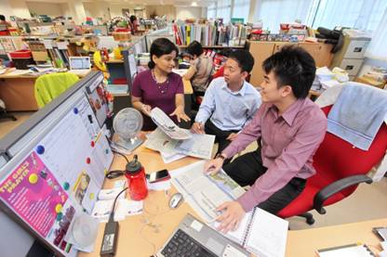
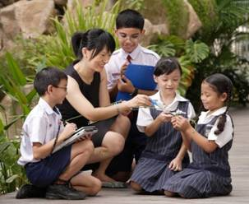
2. Making Every School A Good School
1
2
  Changing the way we Recognise Good Schools
  Making Schools Centers of Innovation
  Relooking the Structure and Profile of the School Team
3
4
  Supporting Our Teachers
Notes:
To deliver student-centric, values-driven education, we want to encourage every school to build its own distinctive niche, with broader measures of what it means to be “Good”, to cater to the entire spectrum of students.
Re-defining good schools
Not merely about academic performance, or being good relative to other schools
A good school needs to know who their students are at the point of entry, studies their needs and strengths; states what it would like them to become when they leave the school; then exercise diligence and imagination to get there.
A good school creates a positive experience for each student – allowing him to acquire the basics, but more importantly, making him a confident and lifelong learner. It provides a supportive and appreciative environment for teachers to experience the joy in impacting lives.
A good school is student-centric and allows teachers to do their best for every child.
Reviewing our School Excellence Model and Masterplan of Awards to support new definition of good schools
2. Encouraging schools to be centres of innovation
MOE will identify areas of focus and encourage schools to collectively innovate to address these challenges and to diffuse innovation across the system.
For such collaborative innovations, we will provide funding as well as training and consultancy for schools.
3. Profession-led excellence – to be elaborated on in later slides
4. Review the structure and profile of the school team to allow teachers more time and space to focus on the students

Slide 15

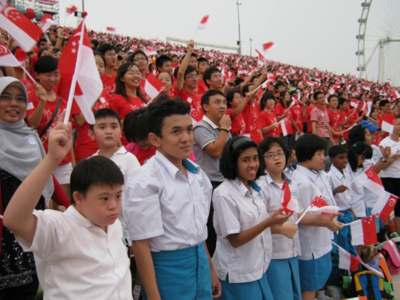
3. Providing Opportunities for All…
Pre-School Education
Not mandatory, but 99% of each cohort attends at least one year of pre-school
Improving Quality and Access
  Minimum teacher qualifications
  Singapore Pre-school Accreditation Framework (SPARK)
Intervention Programmes
Learning Support Programmes
  Lower Primary Levels
Notes:
While we enhance opportunities for our students to realise their aspirations, we will not leave any child behind.
To ensure that children start off with a solid foundation, we have taken various measures to raise the quality of pre-school education. For example, we have raised the min. qualifications of pre-school teachers and recently implemented a new accreditation framework for the pre-school sector (called SPARK) to ensure centre and programme quality.
For students that need extra help in school, early intervention programmes, such as the Learning Support Programme, will provide them with additional support from lower primary levels. This is to help these students improve in English oracy and literacy, as well as numeracy skills. These skills are critical for their subsequent learning in other subjects.
LSP
The Learning Support Programme (LSP) supports children who enter Primary 1 with very weak oral English language and literacy skills. These children, ~12-14% of each cohort, are identified at the start of Primary 1 through a screening test.
They are provided daily support by specially trained teachers, using a research-based intervention curriculum. All primary schools have a full-sized classroom, additional teacher posts and specialized teacher training for the LSP. The LSP also allows teachers to identify students who were dyslexic and to refer them for specialised intervention for dyslexia at P3.
65% are able to read at their age level and pass their school’s EL exams by end of P2. Diagnostic screenings found that around 70% of the remaining pupils were dyslexic.
LSM
There is an equivalent programme for numeracy, Learning Support for Mathematics (LSM) which adopts a pull-out approach and lasts for 1 year. Each year, about 5-6% of P1 pupils are identified to require LSM support for learning in Mathematics.
[Note: LSM success rate is only 30-40% of pupils meet discharge criteria at end of P1, with no systemic provisions for support in P2]

Slide 16
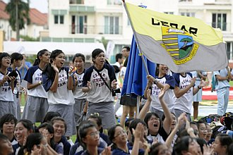
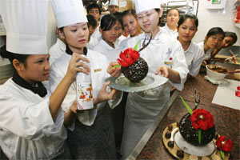
… For Students of Varying Abilities
With Strengths in:
Academics
  Integrated Programme
  Specialised schools in Maths, Science
Non-Academic Fields
  Specialised schools for Sports, Arts
More hands-on learning
Specialised schools with focus on vocational skills
Notes:
We have designed multiple pathways to cater to diverse learning styles:
From 2013, 15 schools will offer the Integrated Programme to academically-strong students to stretch them in other domains. We have also set up specialised schools such as NUS High School of Mathematics and Science, Singapore Sports School and the Singapore of the Arts to cater to students with exceptional talents in non-academic fields.
We have also set up specialised schools focused on vocational skills. Crest Secondary School, the first of two Specialised Schools for Normal (Technical) (SSNT) students, will start to admit students from January 2013. The school will provide a customised curriculum to suit the learning needs of its students. It will also work closely with the Institute of Technical Education (ITE) and industry partners to develop programmes and attachment opportunities for its students.

Slide 17
… To Ensure that All Children Have Opportunities to Realise Their Aspirations.
For all Singaporeans
  Heavily subsidised (97%) primary and secondary education
  Edusave Funds
    Scholarships, Bursaries, Awards, Enrichment
For needy Singaporeans
  Financial Assistance Schemes
    To cover a range of school essentials
  Opportunity Fund
    To subsidise cost of enrichment programmes for students from lower income households
Notes:
No Singaporean child is denied an education due to financial reasons. To ensure that education is affordable for all children, MOE heavily subsidises primary and secondary education (97%).
Cost to attend primary schools: SGD132 per year = USD 103
Cost to attend secondary schools: SGD 252 per year = USD 197
We also provide all Singaporeans with Edusave funding, started in 1991
Provides students and schools with funds to pay for enrichment programmes or to purchase additional resources - $200 per year at primary level, $240 a year at secondary level
Also encompasses awards to students who perform well or who make good progress in their academic and non-academic work
And scholarships for outstanding students to attend our Independent schools
For needy students, we provide:
Financial assistance schemes that helps needy students cover a range of school essentials
Opportunity Fund that allows schools to subsidize the cost of enrichment programmes for students from lower income households

Slide 18
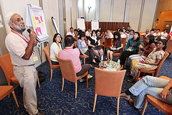

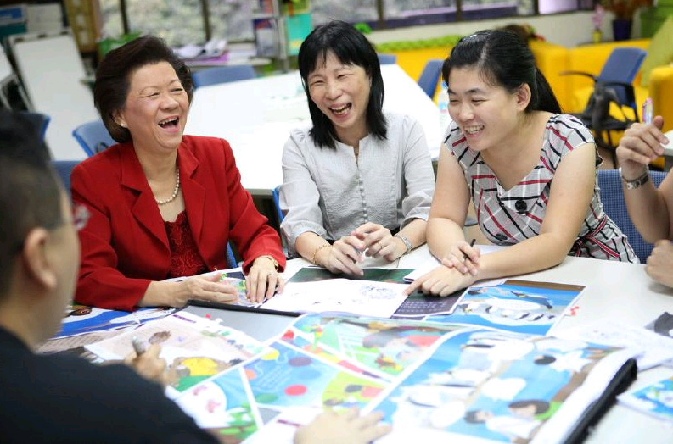
4. Strengthening Partnerships with Parents and the Community.
Parents and the Community play a critical role in education
Build a stronger sense of shared responsibility
Engaging Parents through COMPASS – network of stakeholders to promote home-school community collaborations
Sharpen focus with MOE’s new Partnerships in Education Office
Notes:
Last but not least, we are enhancing our partnerships with parents and the community. We recognise the critical role they play in the education of our children – for many teachable moments occur outside of the classroom and “it takes a village to raise a child”.
We seek to strengthen these partnerships by: (a) Building a stronger sense of shared responsibility between parents, school, teachers and society for the education of our children, and (b) Fostering a greater clarity of and respect for each of these roles.
We have been and will continue to engage parents through COMPASS (COMmunity and PArents in Support of Schools) – a network established to advise MOE on ways to strengthen and promote home-school-community collaborations and which draws its members from various stakeholders representing parents, self-help groups, alumni and the business community.
To bring sharper focus on strengthening partnerships, we have set up a new Partnerships in Education Office (PEO). Set up in 2011, it will spearhead initiatives to engage the public constructively on education issues and support the work of COMPASS. In 2012, MOE provided all schools with a Parent Support Group (PSG) Fund, which is a seed funding of $2,500, for innovative efforts at engaging parents via outreach programmes and parent-child bonding events.

Slide 19
(2) Current Trends in Singapore’s Education Landscape
    Delivering a Student-Centric, Values-Driven Education
    Nurturing a Quality Teaching Force
19

Slide 20
In Nurturing a Quality Teaching Force, We Continue to Ensure that Teaching is an Attractive Job…
Teaching is an Attractive Job
  Competitive Salaries
  Holistic Development
    TEACH framework
  Good career prospects
    More career progression opportunities
    Increased leadership and professional development opportunities
20
Notes:
With the introduction of recent initiatives, we will require more resources as well as professional competence among teachers. We will continue to invest in our teachers, as they are the frontline of our delivery of education.
First, we work to ensure that teaching is an attractive job.
We pay our teachers salaries that are comparable to what they would otherwise get in other jobs in the market.
We recently developed a “TEACH” framework to develop our teachers holistically to better fulfil their mission effectively, while motivating and renewing their passion for teaching. At its core is strengthening teachers’ professionalism and excellence by improving engagement, fostering a teacher-led culture of professional excellence, providing strong support for upgrading, and helping teachers achieve better work-life balance.
[TEACH stands for Teacher–professionalism based on a self-led culture of professional development; better Engagement by strengthening feedback loops and communication channels with teachers; better alignment with teachers’ Aspirations by providing opportunities for academic upgrading; enhancing their Career advancement options by providing more leadership positions in schools; and providing work-life Harmony to retain good teachers.]
As we expand our teaching force, we will also provide greater career progression opportunities. Teachers can specialise in any of three following tracks: leadership, specialist, and teaching track. Those on the teaching track, for instance, can aspire to become pedagogical leaders, such as Lead Teachers in schools, or even the Principal Master Teacher, which is the apex appointment on the Teaching Track.
We emphasize on leadership and professional development. High potential individuals are sent to attend milestone programmes, such as those that prepare them for principalship in schools. [Milestone programmes for high potential individuals, including postings at MOE HQ. Candidates slated for principalship are required to enroll in a 6-months full-time LEP (Leaders in Education Programme) conducted by NIE, which aims to produce independent, innovative leaders with a specialisation in the field of education.]
We also want to enhance the professional capacity of our teachers. To nurture a teacher-driven culture of professional excellence, MOE will support all schools in establishing themselves as Professional Learning Communities, which will serve as platforms to generate new ideas and facilitate practitioner-oriented learning.
Note: The Sept 2007 McKinsey report on How the world’s best performing school systems come out on top concluded:
“Above all, the top performing systems demonstrate that the quality of an education system depends ultimately on the quality of its teachers. School systems, from Seoul to Chicago, from London to New Zealand, and from Helsinki to Singapore, show that making teaching the preferred career choice depends less on high salaries or ‘culture’ than it does on a small set of simple but critical policy choices: developing strong processes for selecting and training teachers, paying good starting compensation, and carefully managing the status of the teaching profession.”

Slide 21
… which Allows Us to Recruit Good People
Selecting from the Best
  Selecting from top 30% of each cohort
Leading to Lower Pupil-Teacher Ratios
  From 30,000 teaching staff in 2010, to 33,000 by 2015
PTRs in Schools | 2001 | 2011
Primary Schools | 25.1 | 18.6
Secondary Schools | 19.2 | 14.8
21
Notes:
The initiatives that we have put in place have thus enabled us to select from the best: teachers are carefully selected from the top 30% of each cohort, and we are gradually moving towards all-graduate teacher recruitment by 2015. Teachers can also look forward to being better supported as we recruit more Allied Educators, who can provide support in the areas of teaching and learning, special needs and school counselling.
All in all, this creates lower pupil-teacher ratios, which gives us the flexibility to do more, while continually training our teachers
The Pupil-Teacher Ratio in secondary schools is expected to improve from 16:1 in 2009 to 13:1 by end 2015

Slide 22
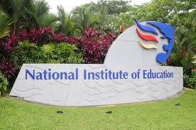

… and Train Them Well.
National Institute of Education
All pre-service teachers will undergo the 1-year Postgraduate Diploma in Education programme.
Academy of Singapore Teachers
Catalyst for the professional development of teachers
Provides in-service training, and support for teacher-led initiatives.
Notes:
It is also our priority to train and develop our teachers professionally.
We also want to enhance the professional capacity of our teachers. To nurture a teacher-driven culture of professional excellence, MOE will support all schools in establishing themselves as Professional Learning Communities, which will serve as platforms to generate new ideas and facilitate practitioner-oriented learning.

Slide 23
Thank you

